Slide 1
Face Recognition System Using Eigenfaces method
A Numerical Methods Project...

Slide 2
TABLE OF CONTENTS
Introduction
Results
Problem Formulation
Conclusion
Problem Statement
Use of Eigenfaces method
References
Methodology
Softwares used
EIgenfaces method as a solution

Slide 3
INTRODUCTION
The face recognition system is similar to other biometric systems. Similar to the fingerprint, the face of an individual has many structures and features unique to that individual.
A face recognition system is based on facial symmetry.
In a face recognition system, the database consists of the images of the individuals that the system has to recognize. If possible, several images of the same individual should be included in the database.
A face recognition algorithm processes the captured image and compares it to the images stored in the database. If a match is found, then the individual is identified. If no match is found, then the individual is reported as unidentified.

Slide 4
PROBLEM STATEMENT
Method | Number of images in the training set | Success Rate
Principal Component Analysis | 400 | 79.65 %
Principal Component Analysis + Relevant Component Analysis | 400 | 92.34 %
Independent Component Analysis | 40 | 81.35 %
Hidden Markov Model | 200 | 84 %
Active Shape Model | 100 | 78.12 - 92.05 %
Wavelet Transform | 100 | 80-91 %
Support Vector Machines | - | 85-92.1 %
Neural Networks | - | 93.7 %
Eigenfaces Method | 70 | 92 - 100 %
The challenges of face recognition are:
Shifting and scaling of the image
Differences in the facial look
Lighting
Aging

Slide 5
Eigenfaces method
Basis of the eigenfaces method is the Principal Component Analysis (PCA).
PCA is a method of projection to a subspace and is widely used in pattern recognition. An objective of PCA is the replacement of correlated vectors of large dimensions with the uncorrelated vectors of smaller dimensions.
Main advantages of the PCA are its low sensitivity to noise, the reduction of the requirements of the memory and the capacity, and the increase in the efficiency due to the operation in a space of smaller dimensions.

Slide 6
Eigenfaces method (Contd.)
In eigenfaces method we extract the characteristic features on the face and representing the face in question as a linear combination of the eigenfaces obtained from the feature extraction process.
The principal components of the faces in the training set are calculated. Recognition is achieved using the projection of the face into the space formed by the eigenfaces.
A comparison on the basis of the Euclidean distance of the eigenvectors of the eigenfaces and the eigenface of the image under question is made.
If this distance is small enough, the person is identified. On the other hand, if the distance is too large, the image is regarded as unrecognized.

Slide 7
REASONS FOR USING EIGENFACES METHOD
The reasons for selecting the eigenfaces method for face recognition are:
Its independence from the facial geometry
The simplicity of realization
Possibility of real-time realization even without special hardware
The ease and speed of recognition with respect to the other methods
The higher success rate in comparison to other methods

Slide 8
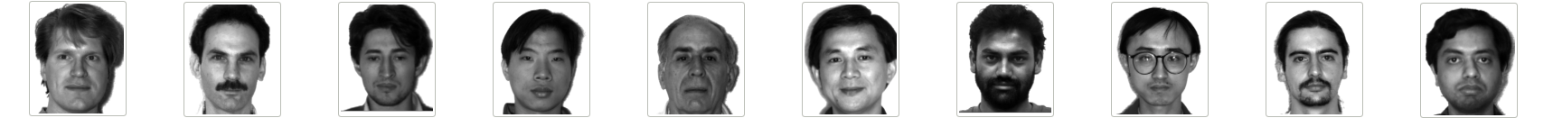
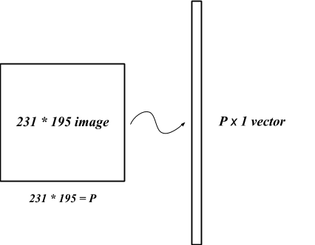
Solution of face recognition problem Using Eigenfaces
A Training Set Consisting of total M images
For each image in Training Set
Images converted to vectors
...
Face Vector Space

Slide 9
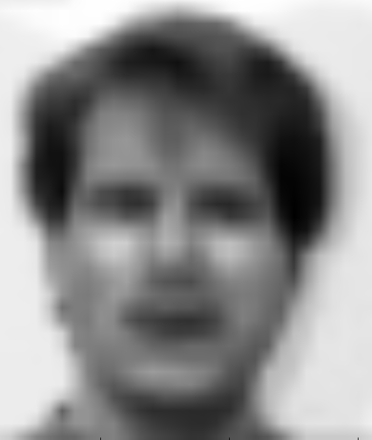
Solution (Contd.)
...
Normalizing Face vectors
( Calculate Average Face )
Subtract the mean face from each face vector to get normalized face vector
...

Slide 10
Solution (Contd.)
...
Calculate the covariance Matrix
C = A * A^{T}
P² X M M X P²
= P² X P²
WARNING !!
System may slow down or run out of memory
Computations requires are huge
2500 Eigenvectors
...
If image is 50 by 50, then we get C
2500 X 2500
Each 2500 X 1
Dimensional

Slide 11
Solution (Contd.)
SOLUTION :
DIMENSIONALITY REDUCTION
Calculate eigenvectors from a Covariance with a reduced dimensionality
If image is 50 by 50, and we have 100 training sets, then we get C as 100 X 100
C = A^{T} * A
M X P² P² X M
= M X M
...
Train the recognizer
(Select K best eigenfaces such that K < M and can represent the whole dataset )
...
100 Eigenvectors
Each 100 X 1 Dimensional

Slide 12
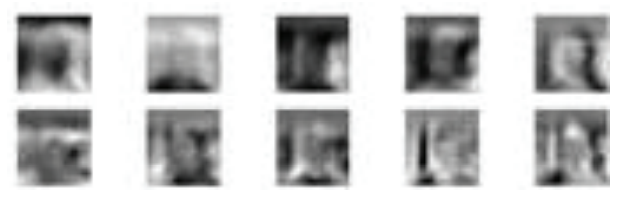
Solution (Contd.)
Now, selected K eigenvalues must be in original dimensionality of the Face Vector Space
...
K selected eigenfaces
= A
u_{i} = A v_{i}

Slide 13
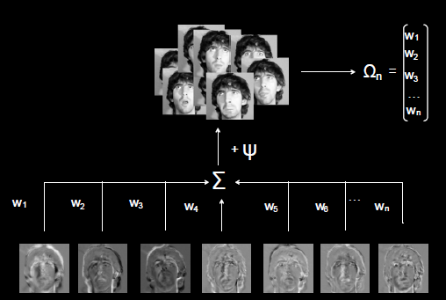
Solution (Contd.)
Represent each face image as linear combination of all K eigenvectors

Slide 14
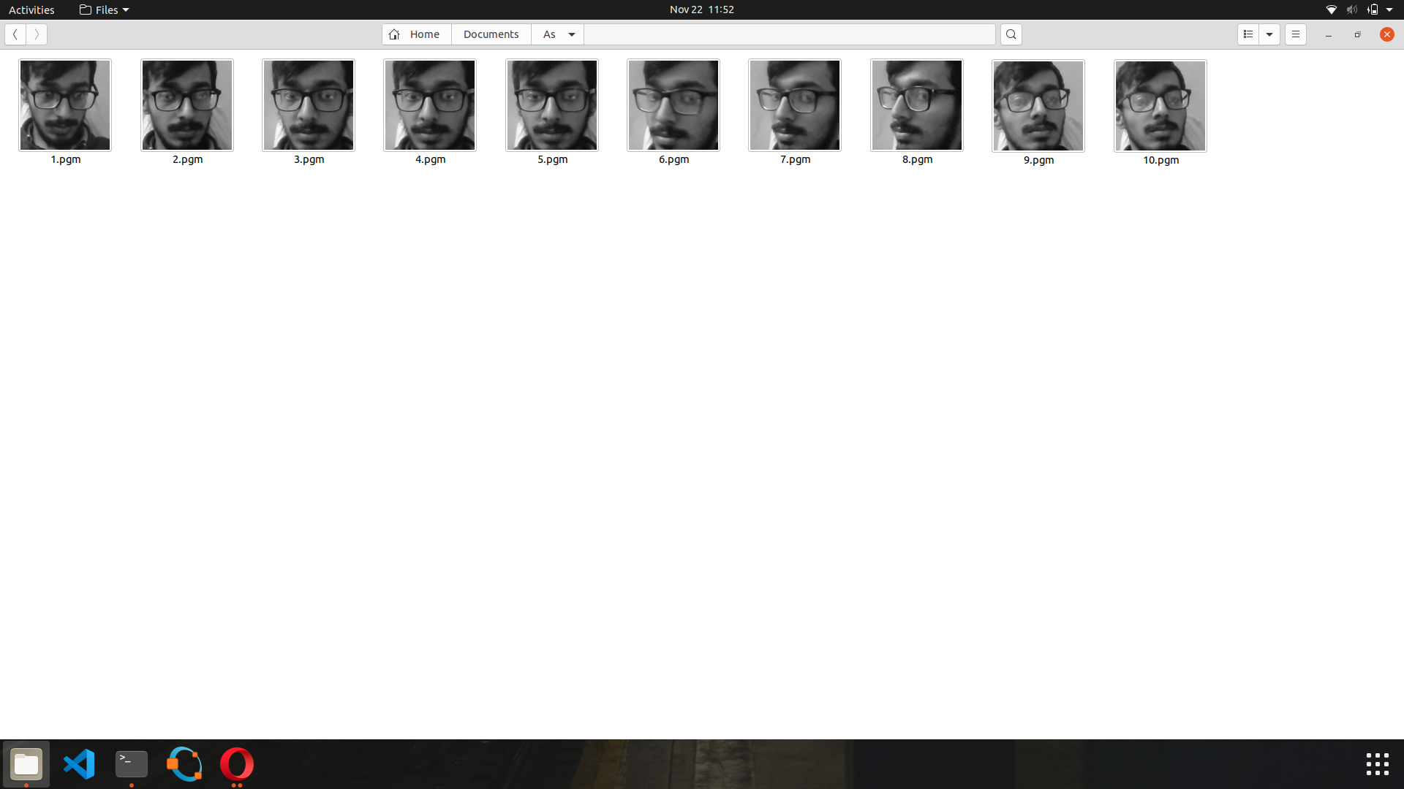
Recognizing an unknown face :
To represent the unknown face as a combination of K eigenfaces
Convert the input image to a face vector
Normalize this face vector
Project normalize face vector onto the Eigenface
Recognized as :
YES
If
d > t
NO
w₁
w₂
.
.
w_{n}
Ω =
Weight vector of input image
UNKNOWN
PERSON
Calculate “distance” between input weight vector and all the weight vectors of training set

Slide 15
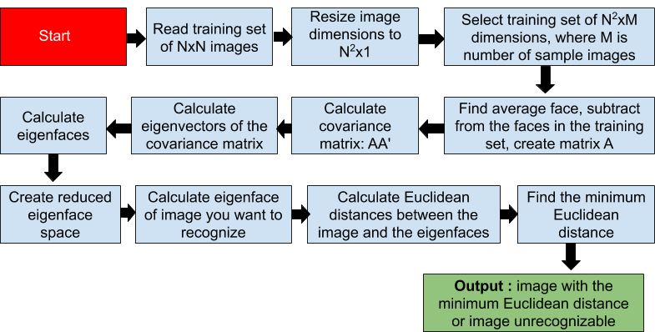
Working of eigenfaces method

Slide 16
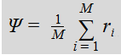
Mathematical POV
Converting N * N images into N² * 1 (Column Vector)
Compute the average of r image vector :
Subtract average face from each face:
Ф_{i} = r_{i} - Ψ. , i = 1,2….., M
Computing the covariance matrix:
C = A^{T}A.
where, A is formed by the difference vectors, i.e.,
A = {Ф₁ ,Ф₂ ,Ф₃ …...Ф_{M} }

Slide 17
Mathematical POV (Contd.)
Calculate the eigenvalues and sort them by using a sorting algorithm :
Using QR Technique
B = M ⁻ ¹ A M.
In the QR method A is reduced to upper (or lower) triangular form and in a triangular matrix, eigenvalues are at the diagonal.
Computing the Eigenvectors corresponding to eigenvalues:

Slide 18
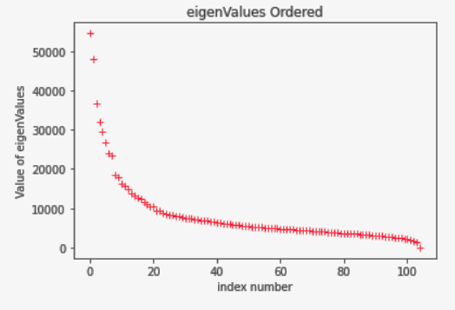
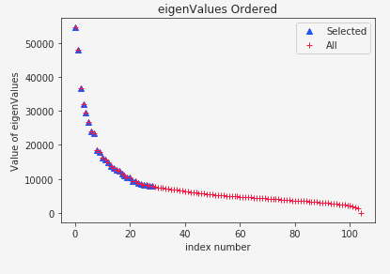
Mathematical POV (Contd.)
Choose the best k eigenvectors and find weights of each image and store it.

Slide 19
Mathematical POV (Contd.)
Read T face images from test set and transform them into linear combinations of eigenfaces.
Calculate the Euclidean distance between each of T test images and N training images.
D = ( Σ [ w(training set) - w(test set) ]² ) ^{-½}
If D = 0 or D < tolerance, person is recognized
Otherwise, the system was not able to recognize the image

Slide 20
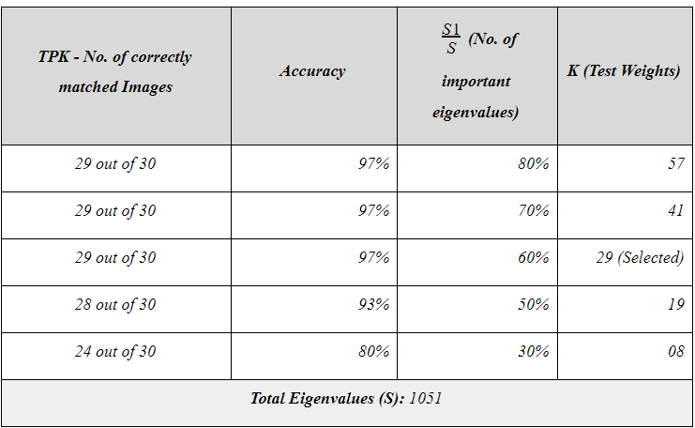
Result Table of Analysis

Slide 21
CONCLUSION
We applied the eigenfaces to a database of 105 images. The success rate is calculated as 100% for the training set and 97% for the test set.
It is sufficient to take about 60% eigenfaces with the highest eigenvalues. It is also clear that the recognition rate increases with the number of training images per person.
If the minimum distance between the test image and other images is zero, the test image entirely matches the image from the training base.
If the distance is greater than zero but less than a certain threshold, it is a known person with another facial expression, otherwise it is an unknown person.

Slide 22
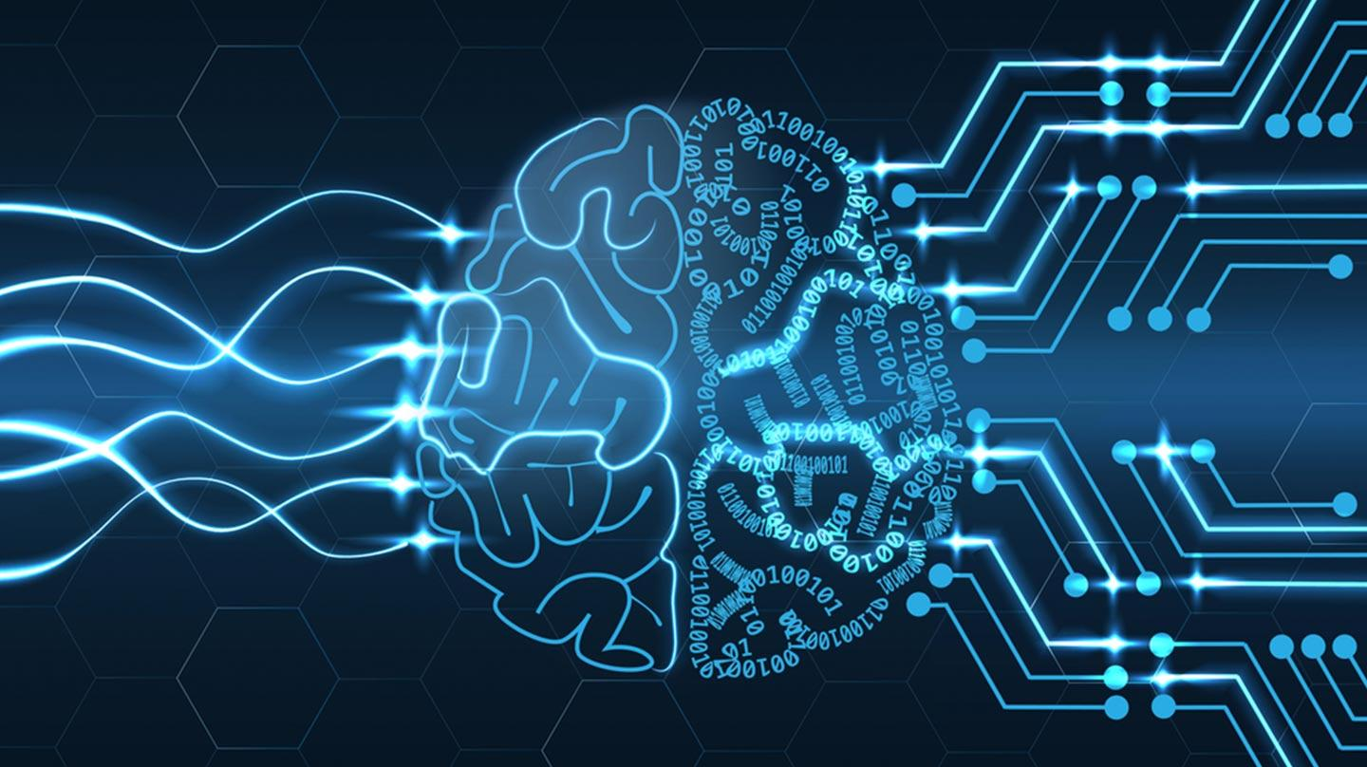
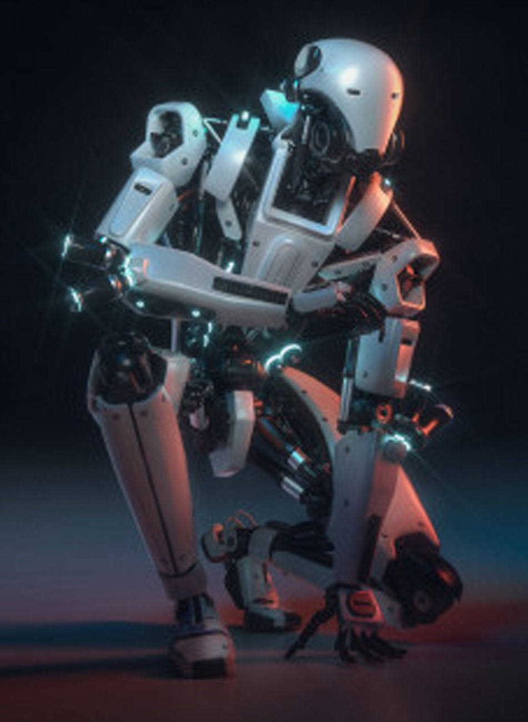
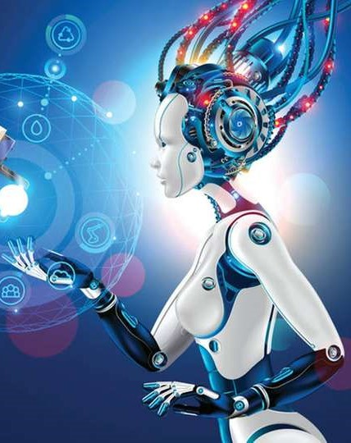


Thank you!
Presented By:
Amit Katyal (11807)
Ashutosh Jha (11811)
Tushar Sethi (11840)

